Slide 1
Raspberry PI to control Bluetooth car
Joe Sovcik, Henry Bond, Mathew Burton-Payne and Murphy Clark

Slide 2
Project Plan
1
Create UML diagram & Flow Diagram
2
Determine required packages
3
Create connection code
4
Form GUI layer
5
Decipher controller input
6
Map interface code
7
Fufill non-functional requirments

Slide 3
Set Functional Requirements
Uses Raspberry PI computer as controller
Communicates through Bluetooth
Full scale movement (forwards, backwards, left, right and stop)
Movement control linked through arrow keys
Movement control using Xbox 360 controller
Automated three point turn
>83%<
COMPLETE
COMPLETE
COMPLETE
COMPLETE
COMPLETE
PENDING

Slide 4
Set Non-Functional Requirements
Functions in real-time
Fits on allocated memory card
Operates using PI hardware
User friendly
Error handling and a robust system
Simple to Reset
Able to process vector commands
uses no more than 512mb of ram
>62.5%<
COMPLETE
PENDING
COMPLETE
COMPLETE
COMPLETE
PENDING
COMPLETE
PENDING

Slide 5
Functional Requirements
Install script for default dependencies/packages
Graphical User Interface
Create associated documentation
>33%<
COMPLETE
PENDING
PENDING

Slide 6
NON-Functional Requirements
Alternative control methods (ie. PS3 Controller)
Random movement function
Circular movement function
Cruise Control
Mouse wheel as alternate speed controller
Controlled Acceleration
>50%<
COMPLETE
PENDING
PENDING
PENDING
COMPLETE
COMPLETE

Slide 7

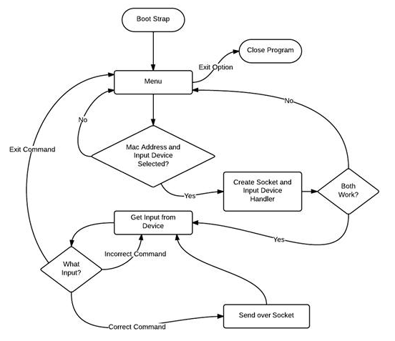
Flow Diagram
Booting
Enter into Menu
Set the mac address and device
Create socket for bluetooth device
Get input from selected device
Send command over bluetooth to car
Car responds Cycle or <End>

Slide 8
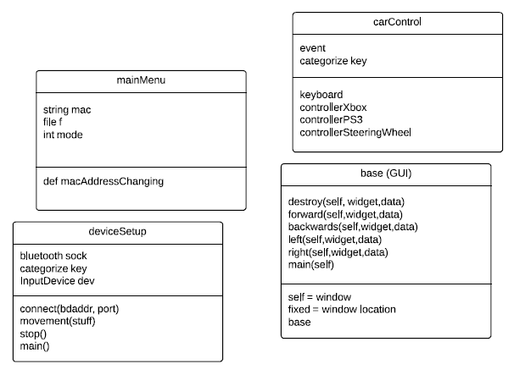
UML Diagram
Standard UML diagram showing key objects required for the program to function
Notes:
UML
Main menu, the string is used to contain the mac address which is written to the file using the variable f
the integer mode is used to control which part of the menu system the user is after, the user will input a number
car control, event and categorize key
the functions for keyboard, controller etc relate to the specific task
the device setup class handles the connection and initialisation of the device, it will detect which usb devices are connected to it, and try to connect to the car, before it connects it will prompt the user whether it wants to update the mac, if not it will try to connect.
It will also handle the disconnection
GUI
destroy – closes the window
directional
and calls itself.

Slide 9
Questions?

